Slide 1
Topic 4 Port Scanning and Ping Sweeps
ST251Y Ethical Hacking and Defences

Slide 2
Topic 4 : Port Scanning and Ping Sweeps
Describe port scanning
Describe different types of port scans
Explain what ping sweeps are used for

Slide 3
Stages of Penetration Testing
Stage 1 : Information Gathering (or Footprinting)
Stage 2 : Network Discovery (includes Port Scanning)
Stage 3 : Vulnerability Assessment
Stage 4 : Exploiting
Stage 5 : Post-Exploit

Slide 4
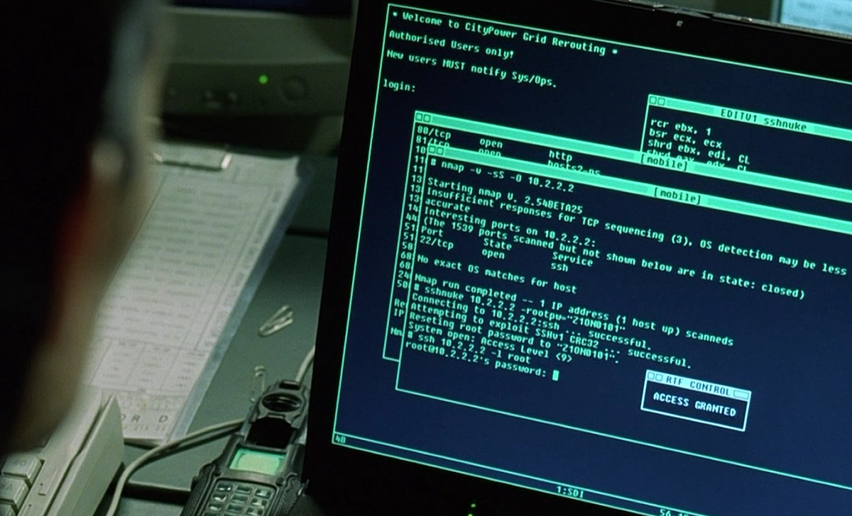
Screenshot from “The Matrix Reloaded” : nmap in action

Slide 5
Introduction to Port Scanning
Port Scanning
Finds out which services are offered by a host
Identifies vulnerabilities
Open services can be used in attacks
Identify a vulnerable port
Launch an exploit
Scan all ports when testing
Not just well-known ports
Port numbers range from 0 to 65535 (for both TCP and UDP)

Slide 6
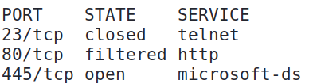
Introduction to Port Scanning
Port scanning programs can report
Open ports
Closed ports (not blocked by firewall, but no service is running on the port)
Filtered ports (possibly behind a firewall)
Best-guess assessment of which OS is running

Slide 7
Port Scanning tools
Nmap
Unicornscan
Nessus
And more…

Slide 8
Nmap (Network Mapper)
One of the most popular tools
Command-line version
GUI version
Zenmap
Open source tool
Standard tool for security professionals

Slide 9
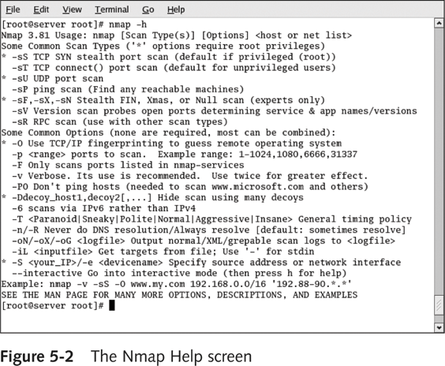
Nmap options

Slide 10
Help for Nmap
Reference Guide from nmap.org
https://nmap.org/book/man.html
Secrets of Network Cartography: A Comprehensive Guide to nmap (especially Chapter 2)

Slide 11
Exercise
Practical 4 Exercise 1 – Using nmap

Slide 12
Types of Port Scans
SYN scan
TCP Connect scan
Completes the three-way handshake
NULL scan
Packet flags are turned off
XMAS scan
FIN, PSH and URG flags are set

Slide 13
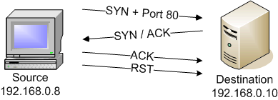
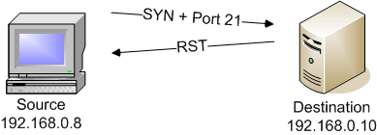
TCP Connect Scan (-sT)
If port is open, full TCP 3 way handshake is established
If port is closed, RST is returned

Slide 14
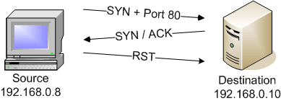

SYN Scan (-sS)
If port is open
If port is closed

Slide 15
SYN Scan
Since the TCP 3-way handshake is not completed, the application will not log the connection
Hence, it is “quieter” or “stealthy” compared to a TCP Connect Scan

Slide 16
FIN, XMAS, Null scans
FIN Scan
Send only packets with the FIN flag on
XMAS Scan
Send packets with FIN, PSH and URG flags on
Null Scan
Send packets with no flags on. Theoretically such null packets can not exist

Slide 17
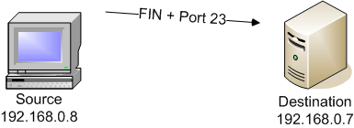
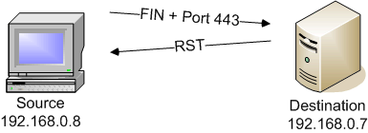
FIN (-sF), XMAS (-sX), Null (-sN) scans
If port is open
If port is closed

Slide 18
FIN, XMAS, Null scans
Also known as stealth scans because only 1 packet is sent and only 1 reply packet is expected
Problem 1:
If firewall blocks the port, no reply is received
Hence, ‘open|filtered’ is received
Problem 2:
Different OS may respond differently
Eg. Windows may reply ‘RST’ regardless of open or closed ports!
Need to use other scans to confirm observation

Slide 19
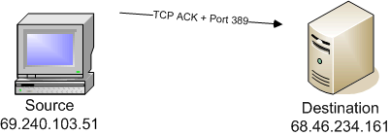
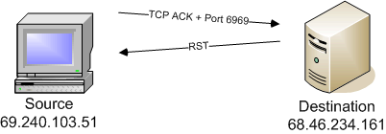
ACK Scan (-sA)
Only reply ‘Filtered’ or ‘Unfiltered’
Use for traversing through firewall
If no response, firewall MAY be present, ie. ‘Filtered’
If RST received, there is no firewall, or the firewall allowed the ACK packet through

Slide 20
Range of ports scanned
Note : Though there are 65,536 possible TCP ports and 65,536 possible UDP ports, nmap by default only scans the most common 1000 ports for each protocol.
nmap determines the most common 1000 ports from the /usr/share/nmap/nmap-services file, based on the frequency indicated in the file.
You can specify which ports you want nmap to scan by using the -p option.

Slide 21
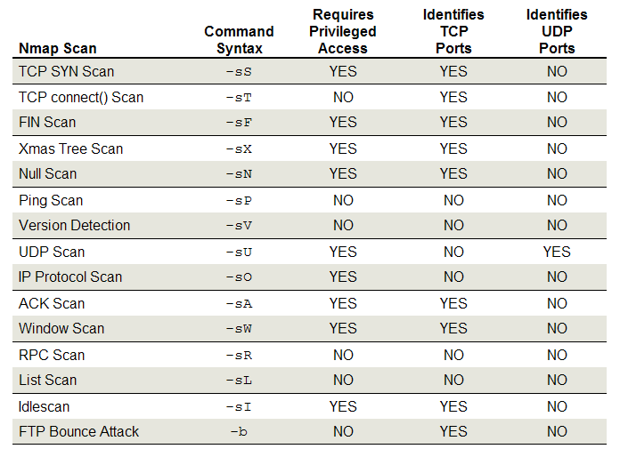
Summary of Nmap scan

Slide 22
Nmap review questions
What does it mean when Nmap reports that a port is filtered?
Port may be blocked by a firewall
For a SYN scan, what does it mean if no response is received?
Port may be blocked by a firewall
For a UDP scan, what does it mean if no response is received?
Port may be opened or blocked by a firewall

Slide 23
Exercise
Practical 4 Exercise 2 – FIN Scan
Practical 4 Exercise 3 – ACK Scan
Practical 4 Exercise 4 – UDP Scan
Practical 4 Exercise 5 – other scans

Slide 24
Avoiding Detection
Port scans are usually “noisy” – generate a lot of traffic suddenly and can slow down network
Attackers may try to avoid sending large number of packets in a short burst of time
Scan throttling- delay the progression of a scan over hours, days or even weeks
Eg one SYN packet sent to one port once every 30 minutes. May be difficult to detect

Slide 25
Avoiding Detection
Common Nmap options for timing
--scan-delay <number of seconds between probes>
--max-rate <number of packets per second>
-T 2 or –T polite slows down the scan
-T 3 or –T normal scan at normal speeds
-T 4 or –T aggressive speeds up the scan

Slide 26
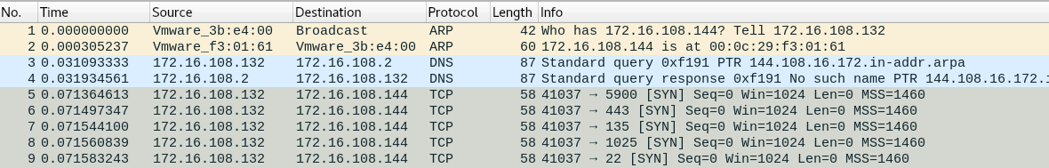
Host Discovery in Nmap
By default, Nmap will try to discover if the host is alive before scanning its ports
If the target is on the same network, Nmap will send an ARP broadcast to discover if the host is up.
The scanner (172.16.108.132/24) is on the same network as the target (172.16.108.144/24)
In Packet 1, an ARP broadcast is sent to discover if 172.16.108.144 is up.

Slide 27
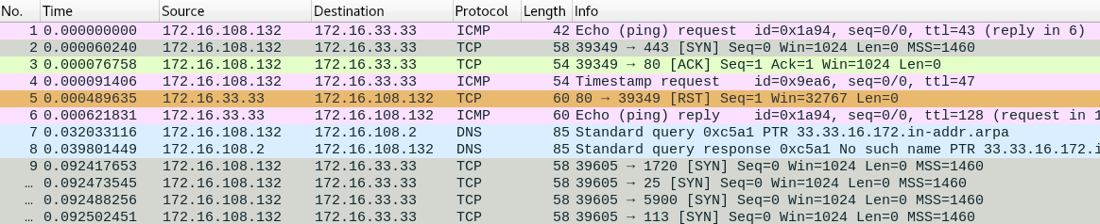
Host Discovery in Nmap
If the target is on a different network, Nmap will send the following to discover if the host is up
ICMP echo request
SYN packet to port 443 and ACK packet to port 80
ICMP timestamp request
The scanner (172.16.108.132/24) is on a different network from the target (172.16.33.33/24)

Slide 28
Host Discovery in Nmap
Common Nmap options for Host Discovery
-sn Do host discovery only (no port scan)
-Pn Do port scanning only (no host discovery)

Slide 29
Unicornscan
Developed in 2004
Ideal for large networks
Scans 65,535 ports in three to seven seconds
Handles port scanning using
TCP
ICMP
IP
Optimizes UDP scanning
Unix-based
URL: http://www.unicornscan.org/

Slide 30
Conducting Ping Sweeps for Host Discovery
Ping sweeps
Identify which IP addresses belong to active hosts
Ping a range of IP addresses
Problems
Computers that are shut down cannot respond
Networks may be configured to block ICMP Echo Requests
Firewalls may filter out ICMP traffic

Slide 31
Fping
fping.sourceforge.net
Ping multiple IP addresses simultaneously
Command-line tool
Input: multiple IP addresses
Entered at a shell
-g option
Input file with addresses
-f option
What is the equivalent nmap command to do a ping sweep?
nmap –sP ip_addr

Slide 32
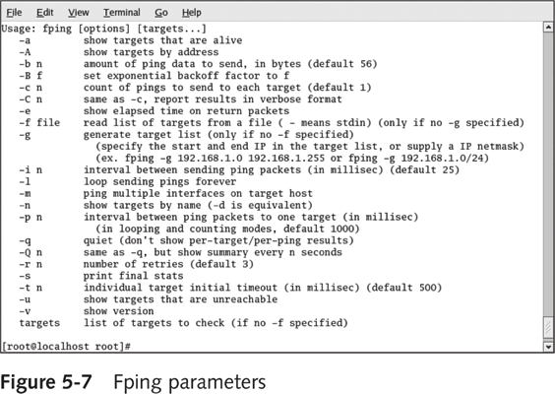

Slide 33
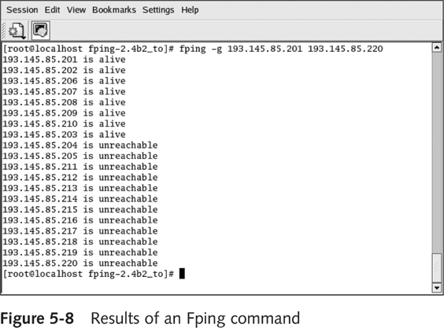

Slide 34
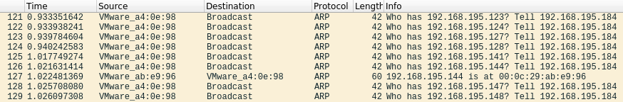
Other methods to do Host Discovey
ARP Broadcasts
Send ARP broadcast requests for a range of IP addresses to see which host will reply
Can only discover hosts in the same network
Can use Netdiscover tool or Nmap with option -sn
In this screenshot, the host 192.168.195.144 has replied that it is up

Slide 35
Hping
Used to bypass filtering devices
Allows users to fragment and manipulate IP packets
www.hping.org
Powerful tool
All security testers must be familiar with tool
Supports many parameters (command options)

Slide 36
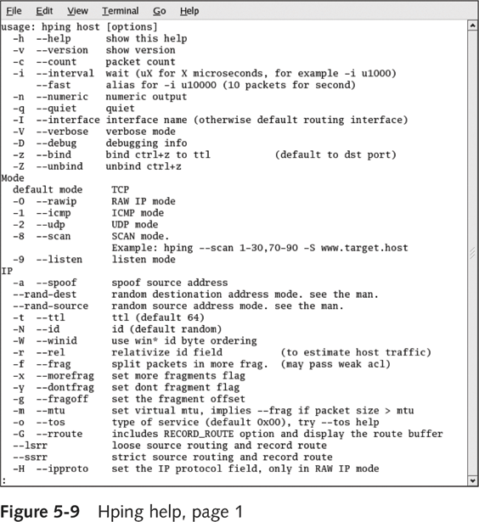

Slide 37
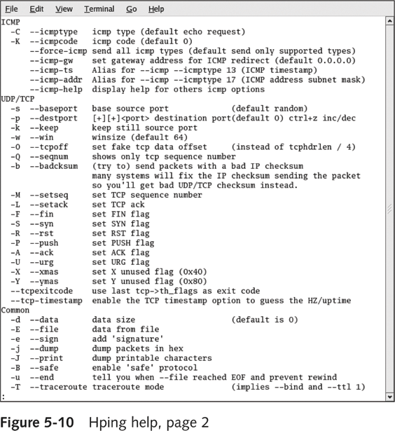

Slide 38
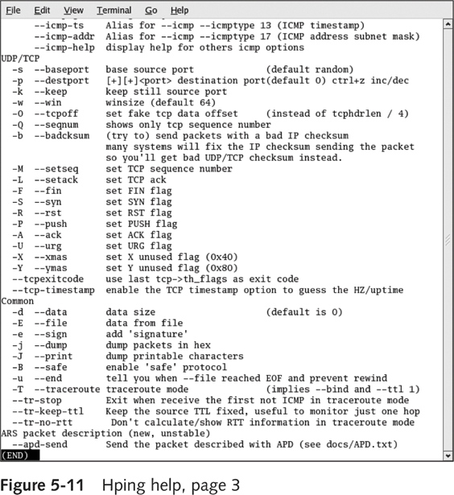

Slide 39
Exercise
Exercise 6 Ping Sweep and Host Discovery
Exercise 7 Hping

Slide 40
Topic 4 Port Scan Summary
Describe port scanning
Describe different types of port scans
SYN Scan
ACK Scan
UDP Scan
Explain what ping sweeps are used for
Host Discovery (to see which hosts are up)
Nmap can also do Host Discovery

